Slide 1
SENG8040 Software Testing Methodologies
Fall 2020
Group 4

Slide 2
Group Information
Lakshay Arora: 8680952
Jacqueline Man Ling Ho: 8719804
Neha Ladani: 8708680
Yasmin Bitar: 8687239

Slide 3
Purpose
Check the informations’ car on the website

Slide 4
List of tools
Git Hub: we use it for code version and automated testing code.
AWS server: using in our manual and automated testings.
Selenium: Automation testing tool
Visual Studio
Node Js Framework
Mysql
Chrome inspection

Slide 5
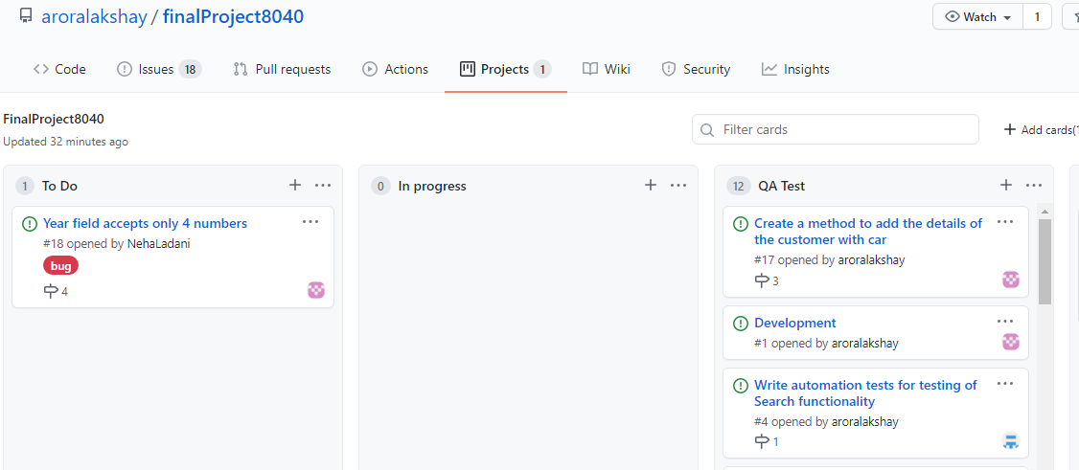
Task Board

Slide 6
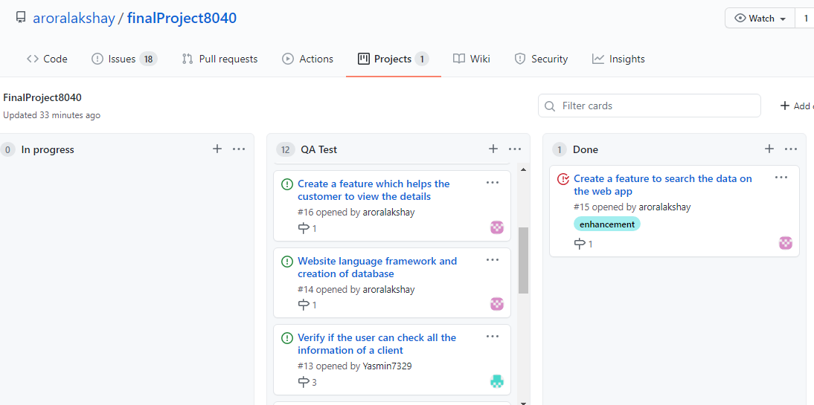
…Continue

Slide 7
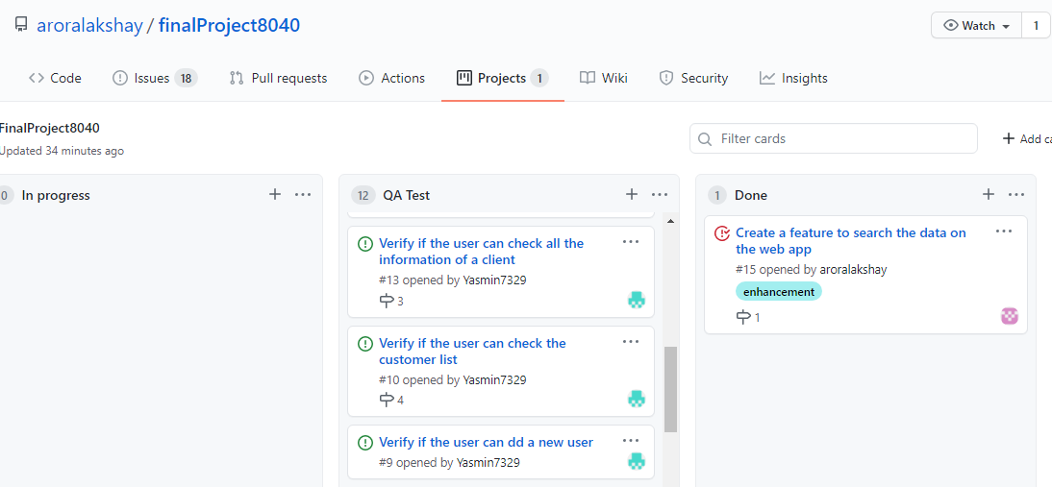
...Continue

Slide 8
...Continue

Slide 9
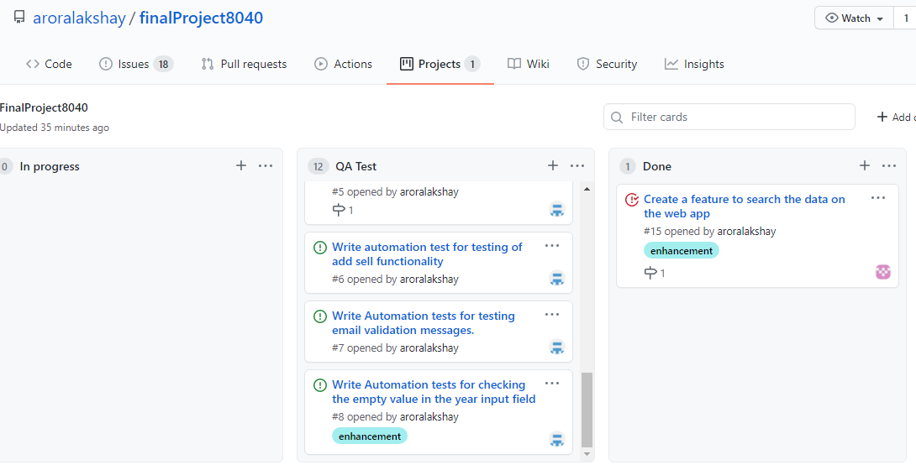
... Continue

Slide 10
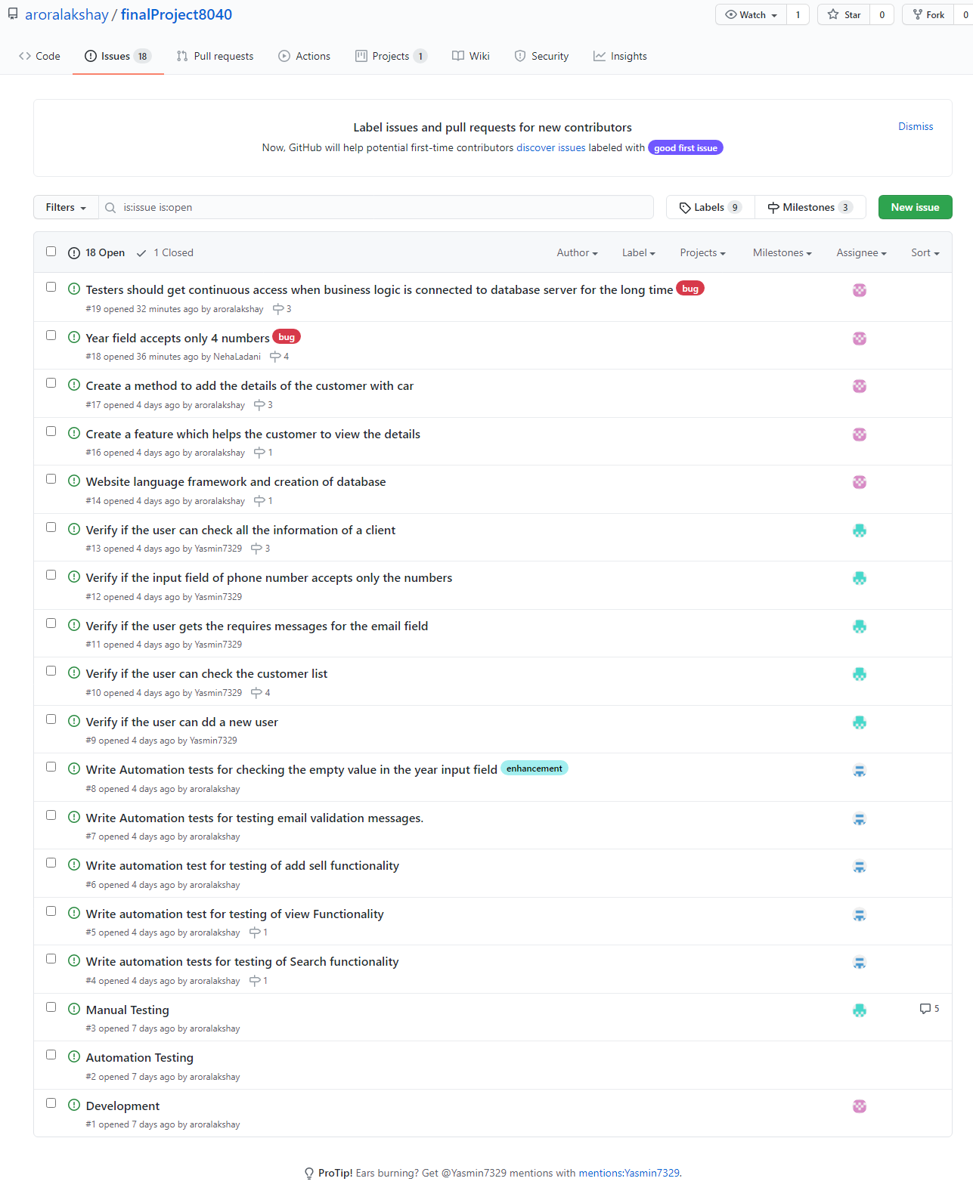
Backlogs(Task List)

Slide 11
Struggles and Risks
Requirements change often
Time limitation
Management time between other activities
The server test admin was a at a different time zone
Lack of techical knowledge while doing testing

Slide 12
Achievement
Even with some struggles, we were able to complete the manual and automated tests.
All the test cases were passing
Testing went smoothly

Slide 13
Thank you!!!!

